Slide 1
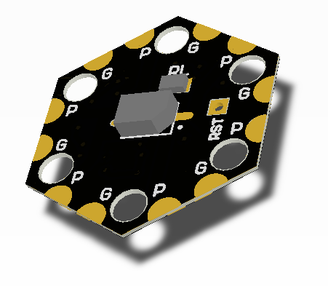
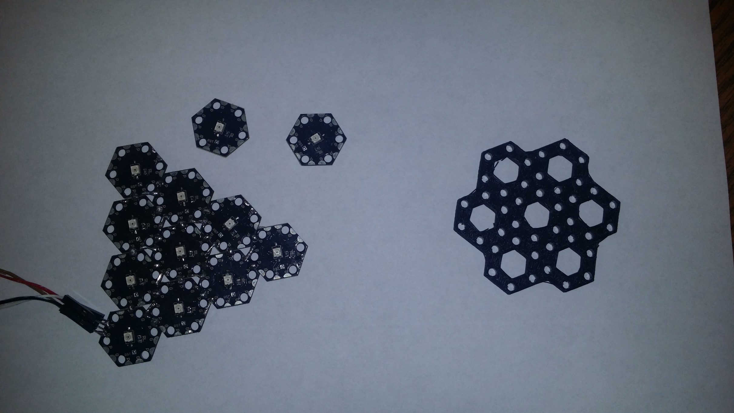

Modular Optical Wireless Elements (MOWE)
Concept & Features
ASAAD KAADAN
June 23, 2014

Slide 2
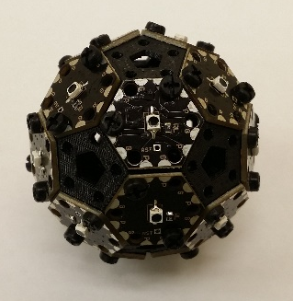
Modular Optical Wireless Elements
MOWE concept.
Hardware design.
Setup & connection.
Command line parser.
Data streaming.
Firmware update.
Useful features.
Useful Tools: Tandy Supercomputer Simulator.
Useful Tools: Automatic Topology Generator.

Slide 3
Modular Optical Wireless Elements
Semiconductor-based optical communication modules featuring fully modular and distributed design.
Inexpensive, lightweight and easy-to-assemble modules for planar and spherical optical arrays.
Modules interconnect with each other without a separate connection apparatus (e.g., cables and connectors), reducing weight, cost and complexity while improving reliability.
Intuitive user interface and ready-to-use APIs to facilitate various applications.
Fully reusable, upgradable and scalable design.

Slide 4

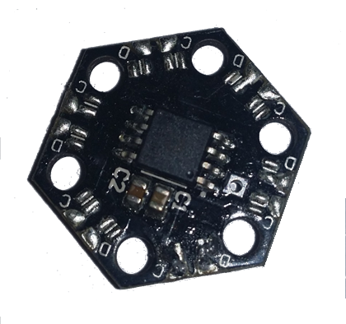
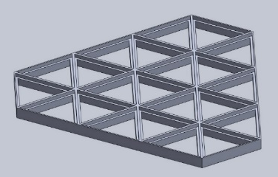
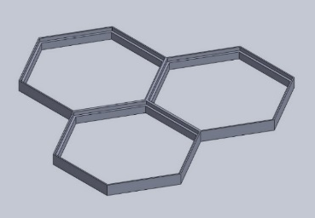
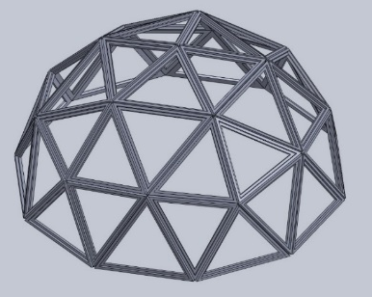
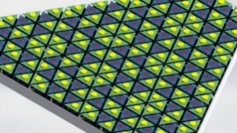
MOWE System Concept
Modules
Array
Frame
Terminal

Slide 5
Hardware Design - 1st Generation
Hexagonal receivers
20mm hexagons
Height: 1.7mm PCB, 5.3mm max
Weight: 0.03 ounce = 0.85 gram (per module)
Atmel 8-bit AVR Microcontroller
Photodiode (VEMT3700):
  Angle of half sensitivity: ϕ = ± 60°
  λ_{0.1} (nm): 450 to 1080
  Peak wavelength response at 850nm
Photodiode (VEMT3700F):
  Angle of half sensitivity: ϕ = ± 60°
  λ_{0.1} (nm): 870 to 1050
  Peak wavelength response at 940nm

Slide 6
Hardware Design – 2nd Generation

Slide 7
1st Generation vs. 2nd Generation
 | 1st Generation | 2nd Generation
Architecture | I2C Bus | Peer-to-peer
Streaming speed | ~100 bps | ~ 1 Mbps
MCU | 8-bit, 24 MHz | 32-bit, 48 MHz, DMAs
ADC | 10-bit | 12-bit
Module height | 20mm | 20mm, 30mm
Module cost | ~ $1 | ~ $4
Module weight | ~ 0.85 g | ~ 2 g
Assembly time |  | 50-80% less
Firmware upgrade | 1 option | 3 options
Extra features |  | Indictor LED Boot and SWD pins

Slide 8
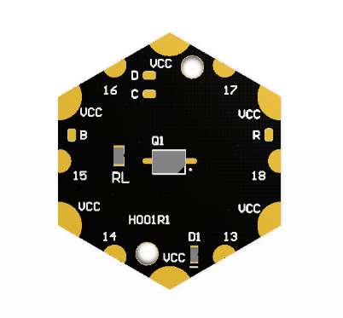
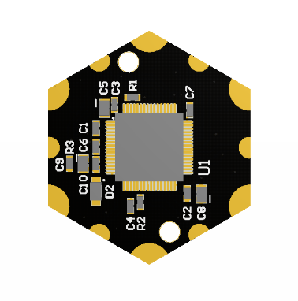
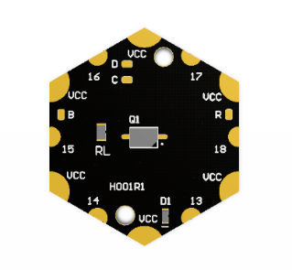
Setup & Connection
PC
+3.3V
GND
TXD
RXD
Use any serial terminal software (RealTerm).
115200 baudrate for command line parser (CLP), 921600 for data streaming.
ASCII display mode.
Might need to check ‘echo’ commands.
PC

Slide 9
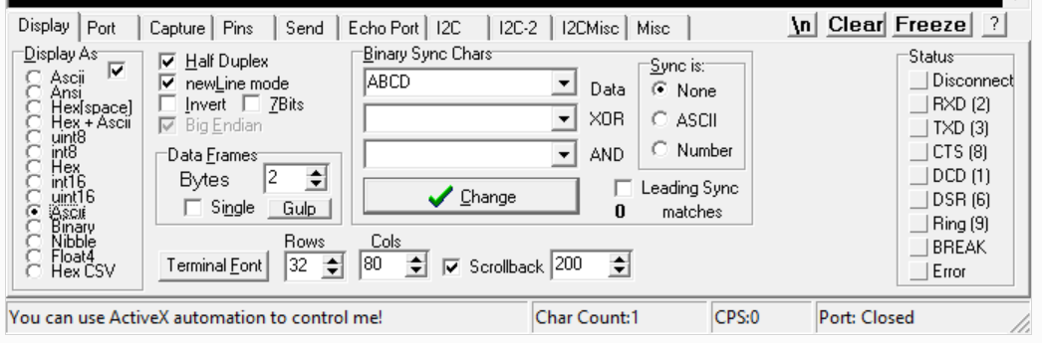
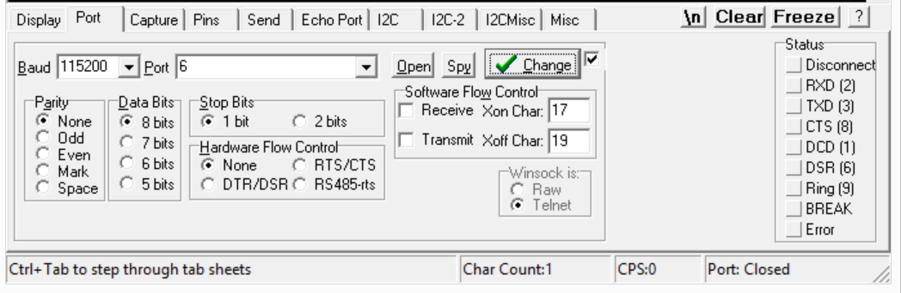
Setup & Connection

Slide 10
Command Line Parser
You can use any port and any module. Just connect to your serial terminal software and hit ‘Enter’.
help display available commands.
Modules are given unique IDs in the form #xxx.
Each module can be named with an alias. You can use the alias wherever the module ID is used.
Most commands can be targeted to: me (the module itself) – ID – alias – all
Consult the ‘Module Firmware Description’ document for more details.

Slide 11
Command Line Parser
Array management:
  name #xxx CoolName Name a module with an alias.
  ping #xxx Ping a module.
  update #XXX Update firmware.
Receivers:
  sample #XXX Read one sample
  read #XXX rate file/port [--noled] Read continuously from a module to any port at a given rate.
  set pdmode #XXX digital/analog Set PD data mode.
  set onelevel/zerolevel #XXX level Set PD discretization level.

Slide 12
Command Line Parser
Transmitters:
  on/off/toggle #XXX Send one signal.
  write #XXX rate file/port [--noled] Write continuously from any port to a module at a given rate.
  pulse #XXX width Send one pulse.
Both
  stream #XXX Stream in/out a module.
  stop/pause #XXX Control reads/writes/streams.
  link #RXX #TXX #TXX Link modules in/out.

Slide 13
Data Streaming
Two backbone communication modes:
  Routing (Single-cast, multicast and broadcast).
    Does not block ports. It transmits and routes data via short packets.
    Not very reliable. Speed is usually in Kbps because of message processing delay.
    Broadcast commands employ random backoff to avoid collision.
  Streaming (SISO and SIMO).
    Dedicated DMA streams with very high speeds (~1-2 Mbps).
    Ports are blocked and must be restored using other ports.
    Very reliable but speed is not controllable and it is difficult to process data.

Slide 14
Data Streaming
How to build streams?
  Each module has 7 available DMA channels (for now):
    5 for port-to-port streams.
    1 for port-to-front-end and vice versa streams.
    1 for memory-to-front-end and vice versa streams.
P6
P5
P1
P4
P2
P3

Slide 15
Data Streaming
How to build streams?
  Each module has 7 available DMA channels (for now):
    5 for port-to-port streams.
    1 for port-to-front-end and vice versa streams.
    1 for memory-to-front-end and vice versa streams.
P6
P5
P1
P4
P2
P3

Slide 16
Data Streaming
How to build streams?
  Each module has 7 available DMA channels (for now):
    5 for port-to-port streams.
    1 for port-to-front-end and vice versa streams.
    1 for memory-to-front-end and vice versa streams.
P6
P5
P1
P4
P2
P3

Slide 17
Data Streaming

Slide 18
Data Streaming

Slide 19
Firmware Update
Three options:
  Use SWD pins to individually program/debug a module.
  Use bootloader to individually program a module.
  Use bootloader to program the entire array.

Slide 20
Firmware Update
Three options:
  Use SWD pins to individually program/debug a module.
  Use bootloader to individually program a module.
  Use bootloader to program the entire array.
    You need an external programmer/debugger.

Slide 21
Firmware Update
Three options:
  Use SWD pins to individually program/debug a module.
  Use bootloader to individually program a module.
  Use bootloader to program the entire array.
    You need to put the module in a bootloader mode:
      Apply +3.3V to the boot pin and reset.
      Or, use the firmware update command update
      When modules arrive from factory, they will be already in bootloader mode.
    Use ‘ST Flash Loader Demonstrator’ tool.
    IMPORTANT: It only works using ‘P1’ (13) port (P2 in the pentagons).

Slide 22
Useful Features
CTRL+z Cycle through the last five commands.
route #xxx #xxx Calculate the shortest route between two modules using Dijkstra's algorithm (source, destination).
Group name #xxx #xxx Group multiple modules.
Reset #xxx Reset a module.
info Useful information about the module and the array plus compile time, date and firmware version.
All module IDs and aliases are checked against a database.
Some errors are given for wrong parameters, wrong syntax or wrong commands.

Slide 23
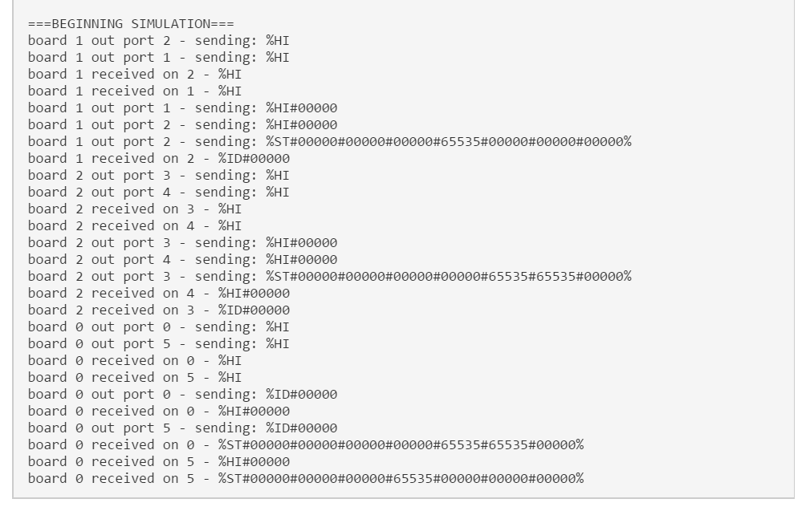
Useful Tools: Tandy Supercomputer Simulator

Slide 24
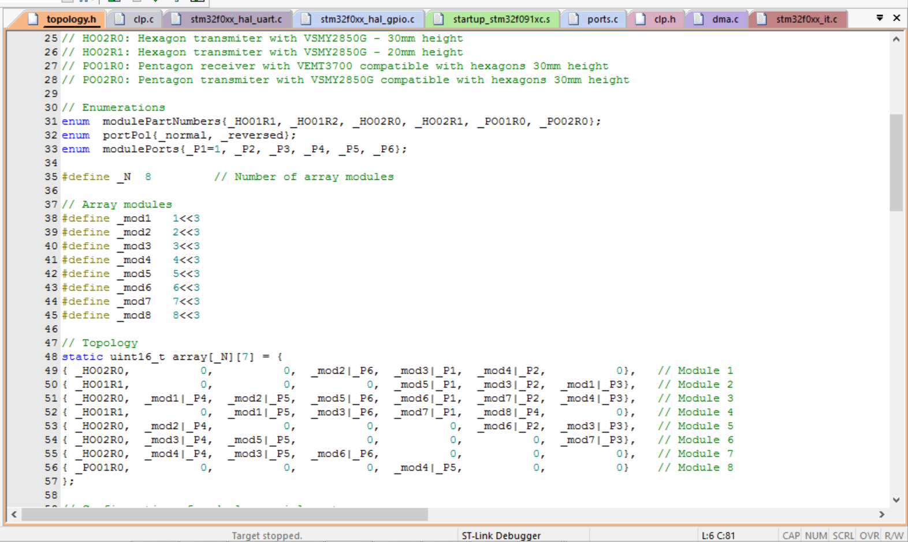
Useful Tools: Automatic Topology Generator

Slide 25


